Slide 1
Application Layer
Prepared by
Dr. Risala Tasin Khan
Professor
IIT, JU

Slide 2
Principles of Network Applications
At the core of network application development is writing programs that run on different end systems and communicate with each other over the network.
For example, in the Web application there are two distinct programs that communicate with each other: the browser program running in the user’s host; and the Web server program running in the Web server host.
Thus, when developing your new application, you need to write software that will run on multiple end systems.
This software could be written, for example, in C, Java, or Python.
Importantly, you do not need to write software that runs on network core devices, such as routers or link-layer switches.

Slide 3
Network Application Architectures
An application’s architecture is distinctly different from the network architecture
The application architecture is designed by the application developer and dictates how the application is structured over the various end systems.
In choosing the application architecture, an application developer will likely draw on one of the two predominant architectural paradigms used in modern network applications: the client-server architecture or the peer-to-peer (P2P) architecture

Slide 4
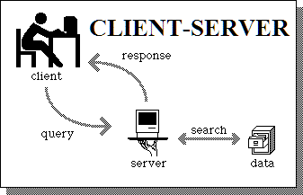
Cont(Client-Server Architecture)
In a client-server architecture, there is an always-on host, called the server, which services requests from many other hosts, called clients.
A classic example is the Web application for which an always-on Web server services requests from browsers running on client hosts.
When a Web server receives a request for an object from a client host, it responds by sending the requested object to the client host.
Note that with the client-server architecture, clients do not directly communicate with each other; for example, in the Web application, two browsers do not directly communicate.
Another characteristic of the client-server architecture is that the server has a fixed, well-known address, called an IP address
Because the server has a fixed, well-known address, and because the server is always on, a client can always contact the server by sending a packet to the server’s IP address.
Some of the better-known applications with a client-server architecture include the Web, FTP, Telnet, and e-mail.

Slide 5
Cont….
Often in a client-server application, a single-server host is incapable of keeping up with all the requests from clients.
For example, a popular social-networking site can quickly become overwhelmed if it has only one server handling all of its requests.
For this reason, a data center, housing a large number of hosts, is often used to create a powerful virtual server.
The most popular Internet services—such as search engines (e.g., Google and Bing), Internet commerce (e.g., Amazon and e-Bay), Web-based email (e.g., Gmail and Yahoo Mail), social networking (e.g., Facebook and Twitter)— employ one or more data centers
Google has 30 to 50 data centers distributed around the world, which collectively handle search, YouTube, Gmail, and other services.
A data center can have hundreds of thousands of servers, which must be powered and maintained.

Slide 6
Cont…(Peer-to-Peer Architecture)
In a P2P architecture, there is minimal (or no) reliance on dedicated servers in data centers.
Instead the application exploits direct communication between pairs of intermittently connected hosts, called peers.
The peers are not owned by the service provider, but are instead desktops and laptops controlled by users, with most of the peers residing in homes, universities, and offices.
Because the peers communicate without passing through a dedicated server, the architecture is called peer-to-peer.
One of the most compelling features of P2P architectures is their self-scalability.
For example, in a P2P file-sharing application, although each peer generates workload by requesting files, each peer also adds service capacity to the system by distributing files to other peers.

Slide 7
Major Challenges of P2P Architecture
ISP Friendly
Most residential ISPs (including DSL and cable ISPs) have been dimensioned for “asymmetrical” bandwidth usage, that is, for much more downstream than upstream traffic.
But P2P video streaming and file distribution applications shift upstream traffic from servers to residential ISPs, thereby putting significant stress on the ISPs.
2. Security
Because of their highly distributed and open nature, P2P applications can be a challenge to secure
3. Incentives
The success of future P2Papplications also depends on convincing users to volunteer bandwidth, storage, and computation resources to the applications, which is the challenge of incentive design

Slide 8
Hybrid of client-server and P2P
Skype
voice-over-IP P2P application
centralized server: finding address of remote party:
client-client connection: direct (not through server)
Instant messaging
chatting between two users is P2P
centralized service: client presence detection/location
user registers its IP address with central server when it comes online
user contacts central server to find IP addresses of buddies

Slide 9
Processes communicating
Process: program running within a host.
within same host, two processes communicate using inter-process communication (defined by OS).
processes in different hosts communicate by exchanging messages
Client process: process that initiates communication
Server process: process that waits to be contacted
Note: applications with P2P architectures have client processes & server processes

Slide 10
The Interface Between the Process and the Computer Network
Most applications consist of pairs of communicating processes, with the two processes in each pair sending messages to each other.
Any message sent from one process to another must go through the underlying network.
A process sends messages into, and receives messages from, the network through a software interface called a socket.

Slide 11
Sockets
If a process is analogous to a house then socket is analogous to door of that house
sending process shoves message out door
sending process relies on transport infrastructure on other side of door which brings message to socket at receiving process
host or
server
host or
server
controlled by
app developer
process
process
socket
socket
TCP with
buffers,
variables
TCP with
buffers,
variables
Internet
controlled
by OS
A socket is the interface between the application layer and the transport layer within a host.
It is also referred to as the Application Programming Interface (API) between the application and the network, since the socket is the programming interface with which network applications are built.

Slide 12
Cont….
The application developer has control of everything on the application-layer side of the socket but has little control of the transport-layer side of the socket.
The only control that the application developer has on the transport-layer side is
(1) the choice of transport protocol and
(2) perhaps the ability to fix a few transport-layer parameters such as maximum buffer and maximum segment sizes .
Once the application developer chooses a transport protocol (if a choice is available), the application is built using the transport-layer services provided by that protocol.

Slide 13
Transport Services Available to Applications
Recall that a socket is the interface between the application process and the transport-layer protocol.
The application at the sending side pushes messages through the socket.
At the other side of the socket, the transport-layer protocol has the responsibility of getting the messages to the socket of the receiving process
What are the services that a transport-layer protocol can offer to applications invoking it?
We can broadly classify the possible services along four dimensions: reliable data transfer, throughput, timing, and security

Slide 14
Reliable Data Transfer
Packets can get lost within a computer network.
For example, a packet can overflow a buffer in a router, or can be discarded by a host or router after having some of its bits corrupted.
For many applications—such as electronic mail, file transfer, remote host access, Web document transfers, and financial applications—data loss can have devastating consequences .
Thus, to support these applications, something has to be done to guarantee that the data sent by one end of the application is delivered correctly and completely to the other end of the application.
If a protocol provides such a guaranteed data delivery service, it is said to provide reliable data transfer.
One important service that a transport-layer protocol can potentially provide to an application is process-to-process reliable data transfer.
When a transport protocol provides this service, the sending process can just pass its data into the socket and know with complete confidence that the data will arrive without errors at the receiving process.
When a transport-layer protocol doesn’t provide reliable data transfer, some of the data sent by the sending process may never arrive at the receiving process. This may be acceptable for loss-tolerant applications, most notably multimedia applications such as conversational audio/video

Slide 15
Throughput
Throughput is the rate at which the sending process can deliver bits to the receiving process.
Because other sessions will be sharing the bandwidth along the network path, and because these other sessions will be coming and going, the available throughput can fluctuate with time.
These observations lead to another natural service that a transport-layer protocol could provide, namely, guaranteed available throughput at some specified rate.
With such a service, the application could request a guaranteed throughput of r bits/sec, and the transport protocol would then ensure that the available throughput is always at least r bits/sec.
For example, if an Internet telephony application encodes voice at 32 kbps, it needs to send data into the network and have data delivered to the receiving application at this rate.
If the transport protocol cannot provide this throughput, the application would need to encode at a lower rate (and receive enough throughput to sustain this lower coding rate) or may have to give up, since receiving, say, half of the needed throughput is of little or no use to this Internet telephony application.
Applications that have throughput requirements are said to be bandwidth-sensitive applications.
While bandwidth-sensitive applications have specific throughput requirements, elastic applications can make use of as much, or as little, throughput as happens to be available.
Electronic mail, file transfer, and Web transfers are all elastic applications

Slide 16
Timing
A transport-layer protocol can also provide timing guarantees
An example guarantee might be that every bit that the sender pumps into the socket arrives at the receiver’s socket no more than 100 msec later.
Such a service would be appealing to interactive real-time applications, such as Internet telephony, virtual environments, teleconferencing, and multiplayer games, all of which require tight timing constraints on data delivery in order to be effective
Long delays in Internet telephony, for example, tend to result in unnatural pauses in the conversation; in a multiplayer game or virtual interactive environment, a long delay between taking an action and seeing the response from the environment (for example, from another player at the end of an end-to-end connection) makes the application feel less realistic

Slide 17
Security
Finally, a transport protocol can provide an application with one or more security services.
For example, in the sending host, a transport protocol can encrypt all data transmitted by the sending process, and in the receiving host, the transport-layer protocol can decrypt the data before delivering the data to the receiving process.
Such a service would provide confidentiality between the two processes, even if the data is somehow observed between sending and receiving processes.
A transport protocol can also provide other security services in addition to confidentiality, including data integrity and end-point authentication

Slide 18
Transport Services provided by the Internet
The Internet (and, more generally, TCP/IP networks) makes two transport protocols available to applications, UDP and TCP.
When you (as an application developer) create a new network application for the Internet, one of the first decisions you have to make is whether to use UDP or TCP.
Each of these protocols offers a different set of services to the invoking applications

Slide 19
Transport service requirements of common apps
Application
file transfer
e-mail
Web documents
real-time audio/video
stored audio/video
interactive games
instant messaging
Data loss
no loss
no loss
no loss
loss-tolerant
loss-tolerant
loss-tolerant
no loss
Throughput
elastic
elastic
elastic
audio: 5kbps-1Mbps
video:10kbps-5Mbps
same as above
few kbps up
elastic
Time Sensitive
no
no
no
yes, 100’s msec
yes, few secs
yes, 100’s msec
yes and no

Slide 20
TCP Services
The TCP service model includes a connection-oriented service and a reliable data transfer service.
When an application invokes TCP as its transport protocol, the application receives both of these services from TCP.
• Connection-oriented service:
TCP has the client and server exchange transport layer control information with each other before the application-level messages begin to flow.
This so-called handshaking procedure alerts the client and server, allowing them to prepare for an onslaught of packets.
After the handshaking phase, a TCP connection is said to exist between the sockets of the two processes.
The connection is a full-duplex connection in that the two processes can send messages to each other over the connection at the same time.
When the application finishes sending messages, it must tear down the connection.

Slide 21
TCP Services (Cont….)
Reliable data transfer service:
The communicating processes can rely on TCP to deliver all data sent without error and in the proper order.
When one side of the application passes a stream of bytes into a socket, it can count on TCP to deliver the same stream of bytes to the receiving socket, with no missing or duplicate bytes

Slide 22
UDP Services
UDP is a no-frills, lightweight transport protocol, providing minimal services.
UDP is connectionless, so there is no handshaking before the two processes start to communicate.
UDP provides an unreliable data transfer service—that is, when a process sends a message into a UDP socket, UDP provides no guarantee that the message will ever reach the receiving process.
Furthermore, messages that do arrive at the receiving process may arrive out of order.
UDP does not include a congestion-control mechanism, so the sending side of UDP can pump data into the layer below (the network layer) at any rate it pleases. (Note, however, that the actual end-to-end throughput may be less than this rate due to the limited transmission capacity of intervening links or due to congestion).

Slide 23
Internet apps: application, transport protocols
Application
layer protocol
SMTP [RFC 2821]
Telnet [RFC 854]
HTTP [RFC 2616]
FTP [RFC 959]
HTTP (eg Youtube), RTP [RFC 1889]
SIP, RTP, proprietary
(e.g., Skype)
Underlying
transport protocol
TCP
TCP
TCP
TCP
TCP or UDP
typically UDP
Application
e-mail
remote terminal access
Web
file transfer
streaming multimedia
Internet telephony

Slide 24
The Web and HTTP
Perhaps what appeals the most to users is that the Web operates on demand. Users receive what they want, when they want it.
It is enormously easy for any individual to make information available over the Web—everyone can become a publisher at extremely low cost.
Hyperlinks and search engines help us navigate through an ocean of Web sites.
Graphics stimulate our senses.
Forms, JavaScript, Java applets, and many other devices enable us to interact with pages and sites.
And the Web serves as a platform for many killer applications emerging after 2003, including YouTube, Gmail, and Facebook.

Slide 25
Overview of HTTP
The Hypertext Transfer Protocol (HTTP), the Web’s application-layer protocol, is at the heart of the Web.
HTTP is implemented in two programs: a client program and a server program.
The client program and server program, executing on different end systems, talk to each other by exchanging HTTP messages.
HTTP defines the structure of these messages and how the client and server exchange the messages.
A Web page (also called a document) consists of objects. An object is simply a file—such as an HTML file, a JPEG image, a Java applet, or a video clip—that is addressable by a single URL.
Most Web pages consist of a base HTML file and several referenced objects. For example, if a Web page contains HTML text and five JPEG images, then the Web page has six objects: the base HTML file plus the five images.
The base HTML file references the other objects in the page with the objects’ URLs.
Each URL has two components: the hostname of the server that houses the object and the object’s path name. For example, the URL
http://www.someSchool.edu/someDepartment/picture.gif
has www.someSchool.edu for a hostname and /someDepartment/ picture.gif for a path name.

Slide 26
HTTP overview
HTTP: hypertext transfer protocol
Web’s application layer protocol
client/server model
client: browser that requests, receives, “displays” Web objects
server: Web server sends objects in response to requests
HTTP request
PC running
Explorer
HTTP response
HTTP request
Server
running
Apache Web
server
HTTP response
Mac running
Navigator

Slide 27
HTTP overview
HTTP defines how Web clients request Web pages from Web servers and how servers transfer Web pages to clients.
When a user requests a Web page (for example, clicks on a hyperlink), the browser sends HTTP request messages for the objects in the page to the server.
The server receives the requests and responds with HTTP response messages that contain the objects
HTTP uses TCP as its underlying transport protocol .
The HTTP client first initiates a TCP connection with the server.
Once the connection is established, the browser and the server processes access TCP through their socket interfaces.
HTTP request
PC running
Explorer
HTTP response
HTTP request
Server
running
Apache Web
server
HTTP response
Mac running
Navigator

Slide 28
HTTP Overview (Cont…)
It is important to note that the server sends requested files to clients without storing any state information about the client.
If a particular client asks for the same object twice in a period of a few seconds, the server does not respond by saying that it just served the object to the client; instead, the server resends the object, as it has completely forgotten what it did earlier.
Because an HTTP server maintains no information about the clients, HTTP is said to be a stateless protocol.

Slide 29
Non-Persistent and Persistent Connections
In many Internet applications, the client and server communicate for an extended period of time, with the client making a series of requests and the server responding to each of the requests.
Depending on the application and on how the application is being used, the series of requests may be made back-to-back, periodically at regular intervals, or intermittently.
When this client-server interaction is taking place over TCP, the application developer needs to make an important decision––
should each request/response pair be sent over a separateTCP connection, or
should all of the requests and their corresponding responses be sent over the same TCP connection?
In the former approach, the application is said to use non-persistent connections; and in the latter approach, persistent connections

Slide 30
HTTP with Non-Persistent Connections
Suppose a Web page is transferring from server to client for the case of non-persistent connections.
Let’s suppose the page consists of a base file and 10 JPEG images, and that all 11 of these objects reside on the same server.
Further suppose the URL for the base HTMLfile is
http://www.someSchool.edu/someDepartment/home.index
Here is what happens:
The HTTP client process initiates a TCP connection to the server www.someSchool.edu on port number 80, which is the default port number for HTTP. Associated with the TCP connection, there will be a socket at the client and a socket at the server.
The HTTP client sends an HTTP request message to the server via its socket. The request message includes the path name /someDepartment/home.index.
The HTTP server process receives the request message via its socket, retrieves the object /someDepartment/home.index from its storage (RAM or disk), encapsulates the object in an HTTP response message, and sends the response message to the client via its socket.
The HTTP server process tells TCP to close the TCP connection. (But TCP doesn’t actually terminate the connection until it knows for sure that the client has received the response message intact.)
The HTTP client receives the response message. The TCP connection terminates. The message indicates that the encapsulated object is an HTML file. The client extracts the file from the response message, examines the HTML file, and finds references to the 10 JPEG objects.
The first four steps are then repeated for each of the referenced JPEG objects

Slide 31
Cont…
As the browser receives the Web page, it displays the page to the user.
Two different browsers may interpret (that is, display to the user) a Web page in somewhat different ways.
HTTP has nothing to do with how a Web page is interpreted by a client. The HTTP specifications ([RFC 1945] and [RFC 2616]) define only the communication protocol between the client HTTP program and the server HTTP program.
Here, each TCP connection is closed after the server sends the object—the connection does not persist for other objects.
Note that each TCP connection transports exactly one request message and one response message. Thus, in this example, when a user requests the Web page, 11 TCP connections are generated.

Slide 32
Non-Persistent HTTP: Response time
Definition of RTT (round-trip time ):
time for a small packet to travel from client to server and back.
The RTT includes packet-propagation delays, packet queuing delays in intermediate routers and switches, and packet-processing delays.
Response time:
one RTT to initiate TCP connection
one RTT for HTTP request and first few bytes of HTTP response to return
file transmission time
total = 2RTT+transmit time
initiate TCP
connection
RTT
request
file
RTT
time to
transmit
file
file
received
time
time

Slide 33
HTTP with Persistent Connections
Non-persistent connections have some shortcomings.
First, a brand-new connection must be established and maintained for each requested object.
For each of these connections, TCP buffers must be allocated and TCP variables must be kept in both the client and server.
This can place a significant burden on the Web server, which may be serving requests from hundreds of different clients simultaneously.
Second, each object suffers a delivery delay of two RTTs— one RTT to establish the TCP connection and one RTT to request and receive an object.
With persistent connections, the server leaves the TCP connection open after sending a response.
Subsequent requests and responses between the same client and server can be sent over the same connection.
In particular, an entire Web page (in the example above, the base HTML file and the 10 images) can be sent over a single persistent TCP connection.
Moreover, multiple Web pages residing on the same server can be sent from the server to the same client over a single persistent TCP connection. These requests for objects can be made back-to-back, without waiting for replies to pending requests (pipelining).
Typically, the HTTP server closes a connection when it isn’t used for a certain time

Slide 34
User-Server Interaction: Cookies
In general, HTTP server is stateless but it is often desirable for a Web site to identify users, either because the server wishes to restrict user access or because it wants to serve content as a function of the user identity.
For these purposes, HTTP uses cookies.
cookie technology has four components:
(1) a cookie header line in the HTTP response message;
(2) a cookie header line in the HTTP request message;
(3) a cookie file kept on the user’s end system and managed by the user’s browser; and
(4) a back-end database at the Web site.

Slide 35
Suppose Susan, who always accesses the Web using Internet Explorer from her home PC, contacts Amazon.com for the first time.
Let us suppose that in the past she has already visited the eBay site.
When the request comes into the Amazon Web server, the server creates a unique identification number and creates an entry in its back-end database that is indexed by the identification number.
The Amazon Web server then responds to Susan’s browser, including in the HTTP response a Set-cookie: header, which contains the identification number.
For example, the header line might be:
Set-cookie: 1678
When Susan’s browser receives the HTTP response message, it sees the Set cookie: header.
The browser then appends a line to the special cookie file that it manages.
This line includes the hostname of the server and the identification number in the Set-cookie: header.
Note that the cookie file already has an entry for eBay, since Susan has visited that site in the past.
As Susan continues to browse the Amazon site, each time she requests a Web page, her browser consults her cookie file, extracts her identification number for this site, and puts a cookie header line that includes the identification number in the HTTP request.
Specifically, each of her HTTP requests to the Amazon server includes the header line:
Cookie: 1678

Slide 36
In this manner, the Amazon server is able to track Susan’s activity at the Amazon site.
Although the Amazon Web site does not necessarily know Susan’s name, it knows exactly which pages user 1678 visited, in which order, and at what times!
Amazon uses cookies to provide its shopping cart service—Amazon can maintain a list of all of Susan’s intended purchases, so that she can pay for them collectively at the end of the session.
If Susan returns to Amazon’s site, say, one week later, her browser will continue to put the header line Cookie: 1678 in the request messages.
Amazon also recommends products to Susan based on Web pages she has visited at Amazon in the past.
If Susan also registers herself with Amazon—providing full name, e-mail address, postal address, and credit card information—Amazon can then include this information in its database, thereby associating Susan’s name with her identification number (and all of the pages she has visited at the site in the past!).
This is how Amazon and other e-commerce sites provide “one-click shopping”—when Susan chooses to purchase an item during a subsequent visit, she doesn’t need to re-enter her name, credit card number, or address
Although cookies often simplify the Internet shopping experience for the user, they are controversial because they can also be considered as an invasion of privacy.
As we just saw, using a combination of cookies and user-supplied account information, a Web site can learn a lot about a user and potentially sell this information to a third party.

Slide 37
Cookies: keeping “state” (cont.)
client
server
ebay 8734
usual http request msg
Amazon server
creates ID
1678 for user
cookie file
usual http response
Set-cookie: 1678
create
entry
ebay 8734
amazon 1678
usual http request msg
cookie: 1678
cookie-
specific
action
access
one week later:
usual http response msg
backend
database
access
ebay 8734
amazon 1678
usual http request msg
cookie: 1678
cookie-
spectific
action
usual http response msg

Slide 38

Web Caching
A Web cache—also called a proxy server—is a network entity that satisfies HTTP requests on the behalf of an origin Web server.
The Web cache has its own disk storage and keeps copies of recently requested objects in this storage
Once a browser is configured, each browser request for an object is first directed to the Web cache.
As an example, suppose a browser is requesting the object http://www.someschool.edu/campus.gif
The browser establishes a TCP connection to the Web cache and sends an HTTP request for the object to the Web cache.
The Web cache checks to see if it has a copy of the object stored locally. If it does, the Web cache returns the object within an HTTP response message to the client browser.
If the Web cache does not have the object, the Web cache opens a TCP connection to the origin server, that is, to www.someschool.edu. The Web cache then sends an HTTP request for the object into the cache-to-server TCP connection. After receiving this request, the origin server sends the object within an HTTP response to the Web cache.
When the Web cache receives the object, it stores a copy in its local storage and sends a copy, within an HTTP response message, to the client browser
origin
server
Proxy
server
HTTP request
HTTP request
client
HTTP response
HTTP response
HTTP response
client
origin
server

Slide 39
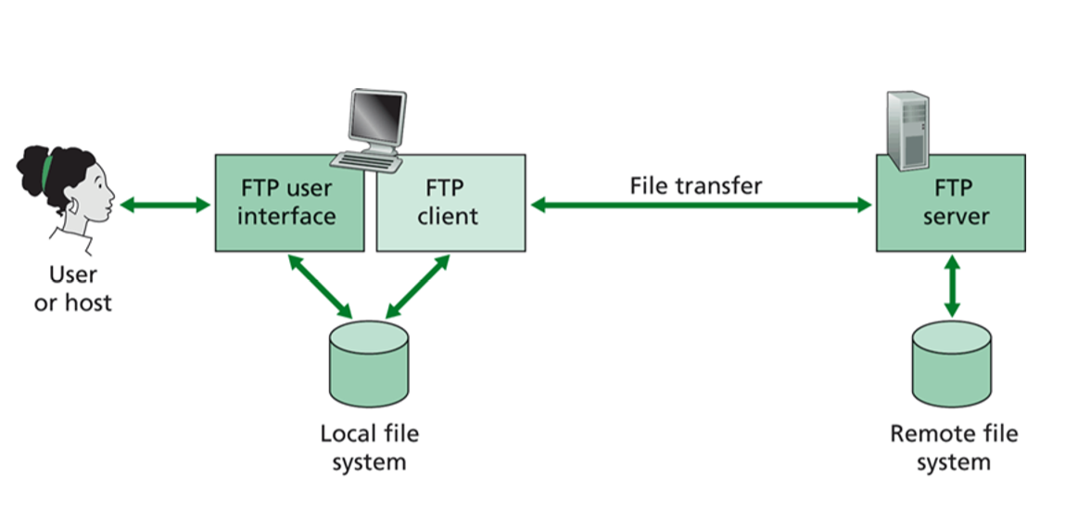
File Transfer: FTP
In a typical FTP session, the user is sitting in front of one host (the local host) and wants to transfer files to or from a remote host.
In order for the user to access the remote account, the user must provide a user identification and a password.
After providing this authorization information, the user can transfer files from the local file system to the remote file system and vice versa.
As shown in Figure, the user interacts with FTP through an FTP user agent.
The user first provides the hostname of the remote host, causing the FTP client process in the local host to establish a TCP connection with the FTP server process in the remote host.
The user then provides the user identification and password, which are sent over the TCP connection as part of FTP commands.
Once the server has authorized the user, the user copies one or more files stored in the local file system into the remote file system (or vice versa).

Slide 40
FTP (Cont….)
FTP, like HTTP, runs on top of TCP.
However, unlike HTTP, FTP uses two parallel TCP connections to transfer a file, a control connection (port #21) and a data connection (port #20).
FTP sends its control information out of band.
In particular, FTP remembers the current directory and earlier authentication that it has used.
The control connection is used for sending control information between the two hosts—information such as user identification, password, commands to change remote directory, and commands to “put” and “get” files.
The data connection is used to actually send a file.

Slide 41
FTP: Cont…
When a user starts an FTP session with a remote host, the client side of FTP (user) first initiates a control TCP connection with the server side (remote host) on server port number 21.
The client side of FTP sends the user identification and password over this control connection.
The client side of FTP also sends, over the control connection, commands to change the remote directory.
When the server side receives a command for a file transfer over the control connection (either to, or from, the remote host), the server side initiates a TCP data connection to the client side.
FTP sends exactly one file over the data connection and then closes the data connection. If, during the same session, the user wants to transfer another file, FTP opens another data connection.
Thus, with FTP, the control connection remains open throughout the duration of the user session, but a new data connection is created for each file transferred within a session
Throughout a session, the FTP server must maintain state about the user.
In particular, the server must associate the control connection with a specific user account, and the server must keep track of the user’s current directory as the user wanders about the remote directory tree.
Keeping track of this state information for each ongoing user session significantly constrains the total number of sessions that FTP can maintain simultaneously.

Slide 42
Electronic Mail in Internet
Electronic mail has been around since the beginning of the Internet.
It remains one of the Internet’s most important and utilized applications.
As with ordinary postal mail, e-mail is an asynchronous communication medium—people send and read messages when it is convenient for them, without having to coordinate with other people’s schedules.
e-mail has three major components: user agents, mail servers, and the Simple Mail Transfer Protocol (SMTP).

Slide 43
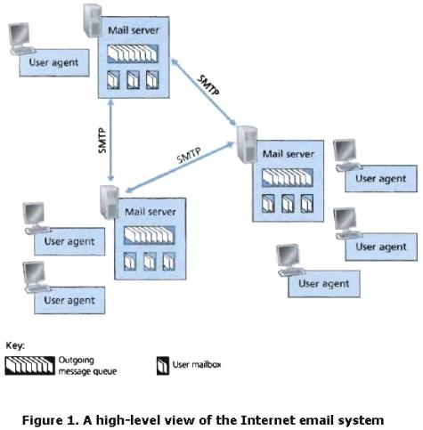
E-Mail (Cont….)
We now describe each of these components in the context of a sender, Alice, sending an e-mail message to a recipient, Bob.
User agents allow users to read, reply to, forward, save, and compose messages. Microsoft Outlook and Apple Mail are examples of user agents for e-mail.
When Alice is finished composing her message, her user agent sends the message to her mail server, where the message is placed in the mail server’s outgoing message queue.
When Bob wants to read a message, his user agent retrieves the message from his mailbox in his mail server.

Slide 44
E-Mail (Cont….)
Mail servers form the core of the e-mail infrastructure.
Each recipient, such as Bob, has a mailbox located in one of the mail servers.
Bob’s mailbox manages and maintains the messages that have been sent to him.
A typical message starts its journey in the sender’s user agent, travels to the sender’s mail server, and travels to the recipient’s mail server, where it is deposited in the recipient’s mailbox.
When Bob wants to access the messages in his mailbox, the mail server containing his mailbox authenticates Bob (with usernames and passwords).
Alice’s mail server must also deal with failures in Bob’s mail server.
If Alice’s server cannot deliver mail to Bob’s server, Alice’s server holds the message in a message queue and attempts to transfer the message later.
Reattempts are often done every 30 minutes or so; if there is no success after several days, the server removes the message and notifies the sender (Alice) with an e-mail message
SMTP is the principal application-layer protocol for Internet electronic mail.
It uses the reliable data transfer service of TCP to transfer mail from the sender’s mail server to the recipient’s mail server

Slide 45
SMTP Protocol
SMTP, defined in RFC 5321, is at the heart of Internet electronic mail.
As with most application-layer protocols, SMTP has two sides: a client side, which executes on the sender’s mail server, and a server side, which executes on the recipient’s mail server.
Both the client and server sides of SMTP run on every mail server. When a mail server sends mail to other mail servers, it acts as an SMTP client.
When a mail server receives mail from other mail servers, it acts as an SMTP server.
Suppose Alice wants to send Bob a simple ASCII message.
Alice invokes her user agent for e-mail, provides Bob’s e-mail address (for example, bob@someschool.edu), composes a message, and instructs the user agent to send the message.
Alice’s user agent sends the message to her mail server, where it is placed in a message queue.
The client side of SMTP, running on Alice’s mail server, sees the message in the message queue. It opens a TCP connection to an SMTP server, running on Bob’s mail server.
After some initial SMTP handshaking, the SMTP client sends Alice’s message into the TCP connection.
At Bob’s mail server, the server side of SMTP receives the message. Bob’s mail server then places the message in Bob’s mailbox.
Bob invokes his user agent to read the message at his convenience.

Slide 46
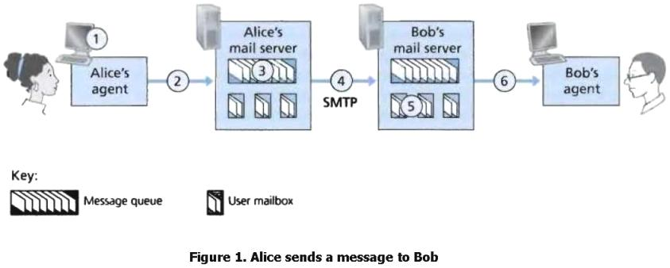
It is important to observe that SMTP does not normally use intermediate mail servers for sending mail, even when the two mail servers are located at opposite ends of the world.
If Alice’s server is in Hong Kong and Bob’s server is in St. Louis, the TCP connection is a direct connection between the Hong Kong and St. Louis servers.
In particular, if Bob’s mail server is down, the message remains in Alice’s mail server and waits for a new attempt—the message does not get placed in some intermediate mail server.

Slide 47
SMTP (Cont….)
Let’s now take a closer look at how SMTP transfers a message from a sending mail server to a receiving mail server.
First, the client SMTP (running on the sending mail server host) has TCP establish a connection to port 25 at the server SMTP (running on the receiving mail server host).
If the server is down, the client tries again later.
Once this connection is established, the server and client perform some application-layer handshaking—just as humans often introduce themselves before transferring information from one to another, SMTP clients and servers introduce themselves before transferring information.
During this SMTP handshaking phase, the SMTP client indicates the e-mail address of the sender (the person who generated the message) and the e-mail address of the recipient.
Once the SMTP client and server have introduced themselves to each other, the client sends the message.
SMTP can count on the reliable data transfer service of TCP to get the message to the server without errors.
The client then repeats this process over the same TCP connection if it has other messages to send to the server; otherwise, it instructs TCP to close the connection.

Slide 48
Comparison with HTTP
Both protocols are used to transfer files from one host to another: HTTP transfers files (also called objects) from a Web server to a Web client (typically a browser); SMTP transfers files (that is, e-mail messages) from one mail server to another mail server.
When transferring the files, both HTTP and SMTP use persistent connections.
HTTP is mainly a pull protocol—someone loads information on a Web server and users use HTTP to pull the information from the server at their convenience. In particular, the TCP connection is initiated by the machine that wants to receive the file.
On the other hand, SMTP is primarily a push protocol—the sending mail server pushes the file to the receiving mail server. In particular, the TCP connection is initiated by the machine that wants to send the file.
A second difference is that SMTP requires each message, including the body of each message, to be in 7-bit ASCII format.
If the message contains characters that are not 7-bit ASCII (for example, French characters with accents) or contains binary data (such as an image file), then the message has to be encoded into 7-bit ASCII. HTTP data does not impose this restriction.

Slide 49
Puzzle of SMTP
How does a recipient like Bob, running a user agent on his local PC, obtain his messages, which are sitting in a mail server within Bob’s ISP?
Note that Bob’s user agent can’t use SMTP to obtain the messages because obtaining the messages is a pull operation, whereas SMTP is a push protocol.
The puzzle is completed by introducing a special mail access protocol that transfers messages from Bob’s mail server to his local PC.
There are currently a number of popular mail access protocols, including Post Office Protocol—Version 3 (POP3), Internet Mail Access Protocol (IMAP), and HTTP.

Slide 50
POP3
POP3 is an extremely simple mail access protocol.
POP3 begins when the user agent (the client) opens a TCP connection to the mail server (the server) on port 110.
With the TCP connection established, POP3 progresses through three phases: authorization, transaction, and update.
During the first phase, authorization, the user agent sends a username and a password (in the clear) to authenticate the user.
During the second phase, transaction, the user agent retrieves messages; also during this phase, the user agent can mark messages for deletion, remove deletion marks, and obtain mail statistics.
The third phase, update, occurs after the client has issued the quit command, ending the POP3 session; at this time, the mail server deletes the messages that were marked for deletion.

Slide 51
POP3(Cont…)
In a POP3 transaction, the user agent issues commands, and the server responds to each command with a reply.
There are two possible responses:
+OK (sometimes followed by server-to-client data), used by the server to indicate that the previous command was fine;
and -ERR, used by the server to indicate that something was wrong with the previous command.
The authorization phase has two principal commands:
user <username> and pass <password>.
To illustrate these two commands, we suggest that you Telnet directly into a POP3 server, using port 110, and issue these commands.
Suppose that mail Server is the name of your mail server. You will see something like:
telnet mail Server 110
+OK POP3 server ready
username bob
+OK
password hungry
+OK
user successfully logged on

Slide 52
IMAP
With POP3 access, once Bob has downloaded his messages to the local machine, he can create mail folders and move the downloaded messages into the folders.
Bob can then delete messages, move messages across folders, and search for messages (by sender name or subject).
But this paradigm—namely, folders and messages in the local machine—poses a problem for the nomadic user, who would prefer to maintain a folder hierarchy on a remote server that can be accessed from any computer.
This is not possible with POP3—the POP3 protocol does not provide any means for a user to create remote folders and assign messages to folders
To solve this and other problems, the IMAP protocol was invented. Like POP3, IMAP is a mail access protocol.
An IMAP server will associate each message with a folder; when a message first arrives at the server, it is associated with the recipient’s INBOX folder.
The recipient can then move the message into a new, user-created folder, read the message, delete the message, and so on.
The IMAP protocol provides commands to allow users to create folders and move messages from one folder to another.
IMAP also provides commands that allow users to search remote folders for messages matching specific criteria.
Note that, unlike POP3, an IMAP server maintains user state information across IMAP sessions—for example, the names of the folders and which messages are associated with which folders.

Slide 53
Web-Based E-Mail
More and more users today are sending and accessing their e-mail through their Web browsers.
Hotmail introduced Web-based access in the mid 1990s. Now Web-based e-mail is also provided by Google, Yahoo!, as well as just about every major university and corporation.
With this service, the user agent is an ordinary Web browser, and the user communicates with its remote mailbox via HTTP.
When a recipient, such as Bob, wants to access a message in his mailbox, the e-mail message is sent from Bob’s mail server to Bob’s browser using the HTTP protocol rather than the POP3 or IMAP protocol.
When a sender, such as Alice, wants to send an e-mail message, the e-mail message is sent from her browser to her mail server over HTTP rather than over SMTP.
Alice’s mail server, however, still sends messages to, and receives messages from, other mail servers using SMTP.

Slide 54
DNS: The Internet’s Directory Service
There are two ways to identify a host—by a hostname and by an IP address.
People prefer the more mnemonic hostname identifier, while routers prefer fixed-length, hierarchically structured IP addresses.
In order to reconcile these preferences, we need a directory service that translates hostnames to IP addresses.
This is the main task of the Internet’s domain name system (DNS).
The DNS is
(1) a distributed database implemented in a hierarchy of DNS servers, and
(2) an application-layer protocol that allows hosts to query the distributed database.
The DNS servers are often UNIX machines running the Berkeley Internet Name Domain (BIND) software [BIND 2012].
The DNS protocol runs over UDP and uses port 53.
DNS is commonly employed by other application-layer protocols—including HTTP, SMTP, and FTP—to translate user-supplied hostnames to IP addresses

Slide 55
Service provided by DNS (IP Address Obtain)
Let us consider what happens when a browser (that is, an HTTP client), running on some user’s host, requests the URL www.someschool.edu/ index.html.
In order for the user’s host to be able to send an HTTP request message to the Web server www.someschool.edu, the user’s host must first obtain the IP address of www.someschool.edu.
This is done as follows.
The same user machine runs the client side of the DNS application.
The browser extracts the hostname, www.someschool.edu, from the URL and passes the hostname to the client side of the DNS application.
The DNS client sends a query containing the hostname to a DNS server.
The DNS client eventually receives a reply, which includes the IP address for the hostname.
Once the browser receives the IP address from DNS, it can initiate a TCP connection to the HTTP server process located at port 80 at that IP address.

Slide 56
Service provided by DNS (Host aliasing)
A host with a complicated hostname can have one or more alias names.
For example, a hostname such as relay1.west-coast.enterprise.com could have, say, two aliases such as enterprise.com and www.enterprise.com.
In this case, the hostname relay1.westcoast.enterprise.com is said to be a canonical hostname.
Alias hostnames, when present, are typically more mnemonic than canonical hostnames
DNS can be invoked by an application to obtain the canonical hostname for a supplied alias hostname as well as the IP address of the host.

Slide 57
Service provided by DNS (Mail server aliasing)
For obvious reasons, it is highly desirable that e-mail addresses be mnemonic.
For example, if Bob has an account with Hotmail, Bob’s e-mail address might be as simple as bob@hotmail.com.
However, the hostname of the Hotmail mail server is more complicated and much less mnemonic than simply hotmail.com (for example, the canonical hostname might be something like relay1.west-coast.hotmail.com).
DNS can be invoked by a mail application to obtain the canonical hostname for a supplied alias hostname as well as the IP address of the host.

Slide 58
Service provided by DNS (Load Distribution)
DNS is also used to perform load distribution among replicated servers, such as replicated Web servers.
Busy sites, such as cnn.com, are replicated over multiple servers, with each server running on a different end system and each having a different IP address.
For replicated Web servers, a set of IP addresses is thus associated with one canonical hostname.
The DNS database contains this set of IP addresses.
When clients make a DNS query for a name mapped to a set of addresses, the server responds with the entire set of IP addresses, but rotates the ordering of the addresses within each reply.
Because a client typically sends its HTTP request message to the IP address that is listed first in the set, DNS rotation distributes the traffic among the replicated servers.

Slide 59
Overview of How DNS works
Suppose that some application (such as a Web browser or a mail reader) running in a user’s host needs to translate a hostname to an IP address.
The application will invoke the client side of DNS, specifying the hostname that needs to be translated. (On many UNIX-based machines, gethostbyname() is the function call that an application calls in order to perform the translation.)
DNS in the user’s host then takes over, sending a query message into the network.
All DNS query and reply messages are sent within UDP datagrams to port 53.
After a delay, ranging from milliseconds to seconds, DNS in the user’s host receives a DNS reply message that provides the desired mapping.
This mapping is then passed to the invoking application. Thus, from the perspective of the invoking application in the user’s host, DNS is a black box providing a simple, straightforward translation service.
But in fact, the black box that implements the service is complex, consisting of a large number of DNS servers distributed around the globe, as well as an application-layer protocol that specifies how the DNS servers and querying hosts communicate.

Slide 60
Problem of Single DNS Server
A simple design for DNS would have one DNS server that contains all the mappings.
In this centralized design, clients simply direct all queries to the single DNS server, and the DNS server responds directly to the querying clients.
Although the simplicity of this design is attractive, it is inappropriate for today’s Internet, with its vast (and growing) number of hosts. The problems with a centralized design include:
• A single point of failure. If the DNS server crashes, so does the entire Internet!
• Traffic volume. A single DNS server would have to handle all DNS queries (for all the HTTP requests and e-mail messages generated from hundreds of millions of hosts).
Distant centralized database. A single DNS server cannot be “close to” all the querying clients. If we put the single DNS server in New York City, then all queries from Australia must travel to the other side of the globe, perhaps over slow and congested links. This can lead to significant delays.
• Maintenance. The single DNS server would have to keep records for all Internet hosts. Not only would this centralized database be huge, but it would have to be updated frequently to account for every new host.
Therefore, DNS has to be a distributed database system.

Slide 61
A Distributed, Hierarchical Database
In order to deal with the issue of scale, the DNS uses a large number of servers, organized in a hierarchical fashion and distributed around the world.
No single DNS server has all of the mappings for all of the hosts in the Internet. Instead, the mappings are distributed across the DNS servers.
To a first approximation, there are three classes of DNS servers—root DNS servers, top-level domain (TLD) DNS servers, and authoritative DNS servers—organized in a hierarchy .
To understand how these three classes of servers interact, suppose a DNS client wants to determine the IP address for the hostname www.amazon.com.
The client first contacts one of the root servers, which returns IP addresses for TLD servers for the top-level domain com.
The client then contacts one of these TLD servers, which returns the IP address of an authoritative server for amazon.com.
Finally, the client contacts one of the authoritative servers for amazon.com, which returns the IP address for the hostname www.amazon.com.

Slide 62
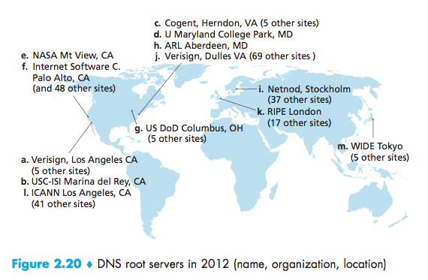
Three Classes of DNS Server
Root DNS servers:
In the Internet there are 13 root DNS servers (labeled A through M), most of which are located in North America.
An October 2006 map of the root DNS servers is shown in Figure 2.20.
Although we have referred to each of the 13 root DNS servers as if it were a single server, each “server” is actually a network of replicated servers, for both security and reliability purposes.

Slide 63
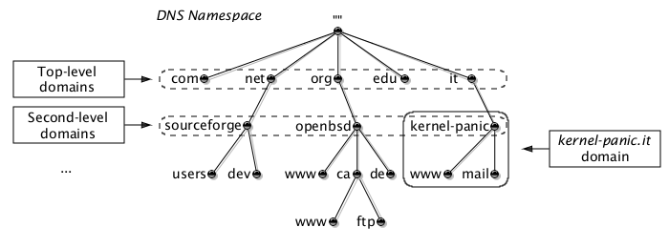
Three Classes of DNS Servers (Cont…)
Top-level domain (TLD) servers
These servers are responsible for top-level domains such as com, org, net, edu, and gov, and all of the country top-level domains such as uk, fr, ca, and jp.
The company Verisign Global Registry Services maintains the TLD servers for the com top-level domain, and the company Educause maintains the TLD servers for the edu top-level domain.

Slide 64
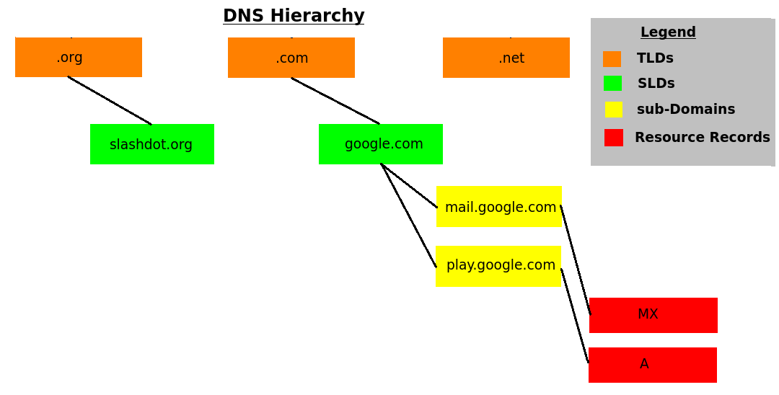
Three Classes of DNS Servers (Cont…)
Authoritative DNS servers
Every organization with publicly accessible hosts (such as Web servers and mail servers) on the Internet must provide publicly accessible DNS records that map the names of those hosts to IP addresses.
An organization’s authoritative DNS server houses these DNS records.
An organization can choose to implement its own authoritative DNS server to hold these records; alternatively, the organization can pay to have these records stored in an authoritative DNS server of some service provider.
Most universities and large companies implement and maintain their own primary and secondary (backup) authoritative DNS server

Slide 65
Three Classes of DNS Servers (Cont…)
Local DNS server:
A local DNS server does not strictly belong to the hierarchy of servers but is nevertheless central to the DNS architecture.
Each ISP—such as a university, an academic department, an employee’s company, or a residential ISP—has a local DNS server (also called a default name server).
When a host connects to an ISP, the ISP provides the host with the IP addresses of one or more of its local DNS servers
When a host makes a DNS query, the query is sent to the local DNS server, which acts a proxy, forwarding the query into the DNS server hierarchy

Slide 66
